Slide 1
WAN INTRODUCTION

Slide 2
What is WAN ?
A WAN is a data communications network that operates beyond the geographic scope of a LAN.
WANs are different from LANs in several ways. While a LAN connects computers, peripherals, and other devices in a single building or other small geographic area, a WAN allows the transmission of data across greater geographic distances.
In addition, an enterprise must subscribe to a WAN service provider to use WAN carrier network services. LANs are typically owned by the company or organization that uses them.

Slide 3
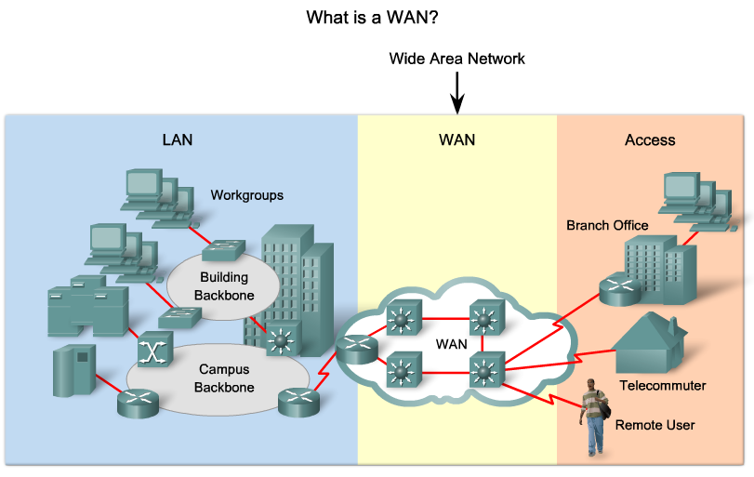
What is WAN ?

Slide 4
What is WAN ?
Here are the three major characteristics of WANs:
  WANs generally connect devices that are separated by a broader geographical area than can be served by a LAN.
  WANs use the services of carriers, such as telephone companies, cable companies, satellite systems, and network providers.
  WANs use serial connections of various types to provide access to bandwidth over large geographic areas.

Slide 5
Why Are WANs Necessary?
LAN technologies provide both speed and cost-efficiency for the transmission of data in organizations over relatively small geographic areas. However, there are other business needs that require communication among remote sites, including the following:
  People in the regional or branch offices of an organization need to be able to communicate and share data with the central site.
  Organizations often want to share information with other organizations across large distances. For example, software manufacturers routinely communicate product and promotion information to distributors that sell their products to end users.
  Employees who travel on company business frequently need to access information that resides on their corporate networks.

Slide 6
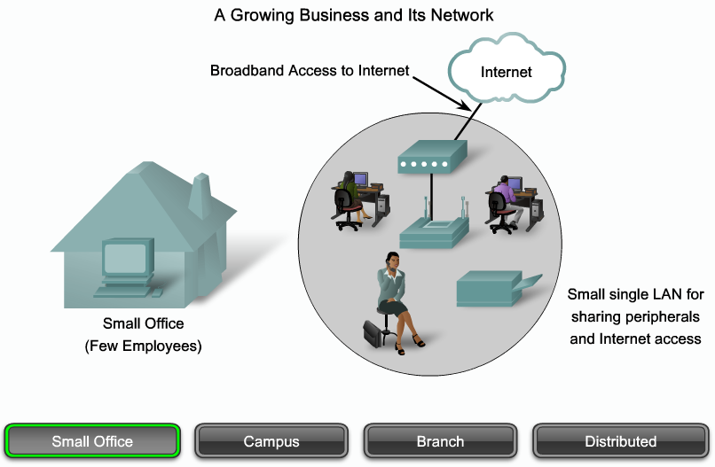
What is WAN ?

Slide 7
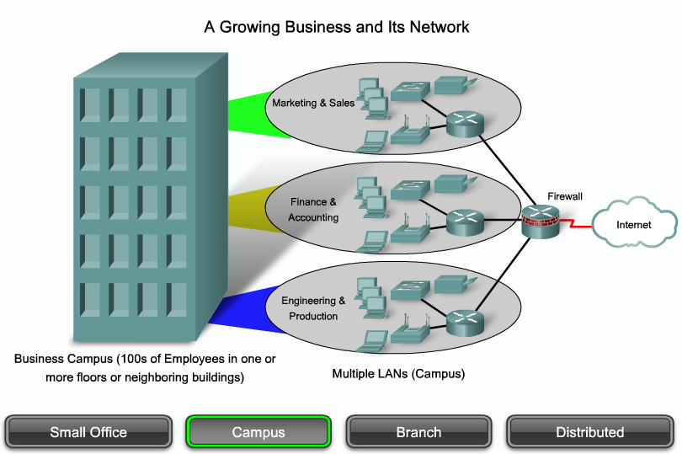
What is WAN ?

Slide 8
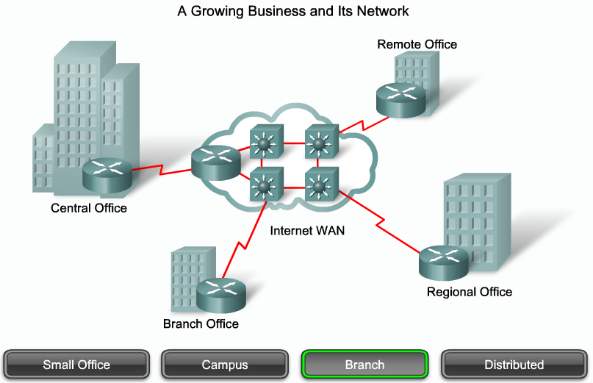
What is WAN ?

Slide 9
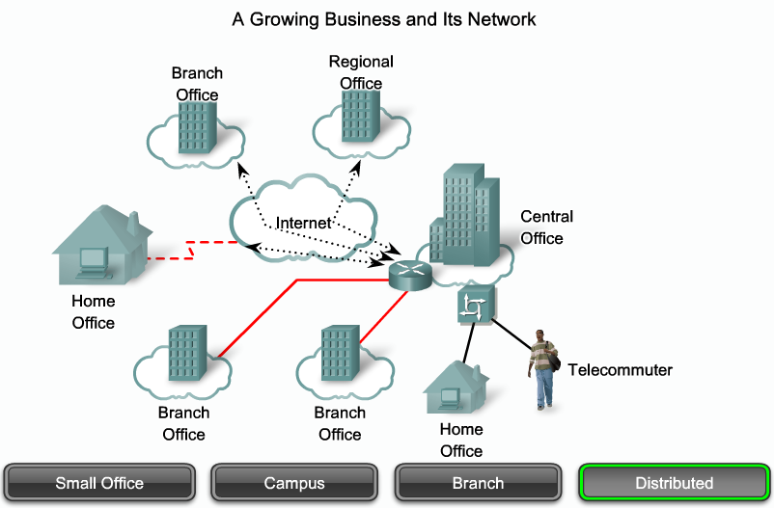
What is WAN ?

Slide 10
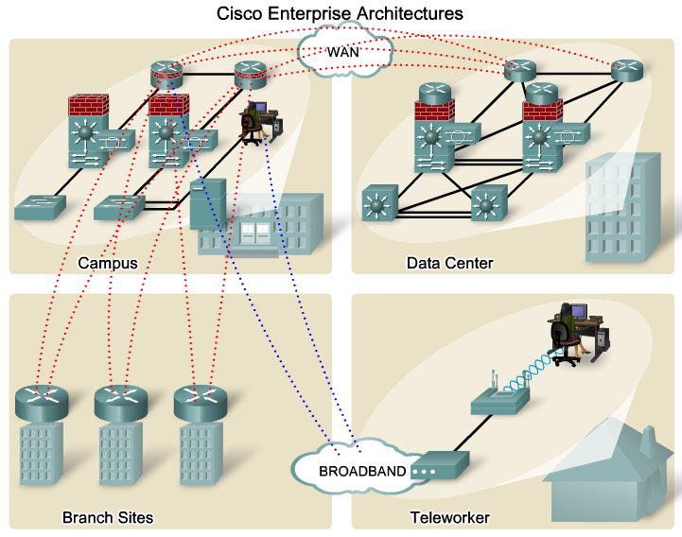
What is WAN ?

Slide 11
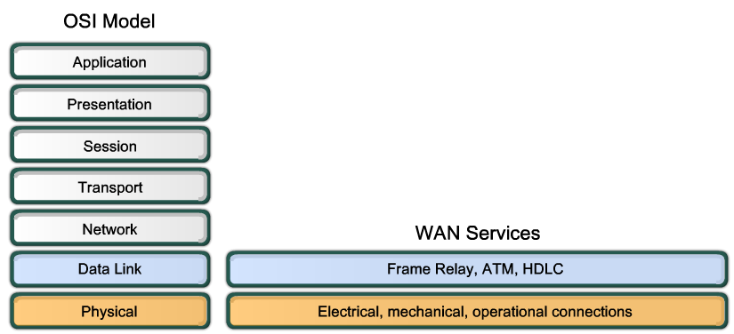
What is WAN ?

Slide 12
WAN Physical Layer Terminology
One primary difference between a WAN and a LAN is that a company or organization must subscribe to an outside WAN service provider to use WAN carrier network services. A WAN uses data links provided by carrier services to access the Internet and connect the locations of an organization to each other, to locations of other organizations, to external services, and to remote users. The WAN access physical layer describes the physical connection between the company network and the service provider network.

Slide 13
WAN Physical Layer Terminology
Customer Premises Equipment (CPE):
  The devices and inside wiring located at the premises of the subscriber and connected with a telecommunication channel of a carrier. The subscriber either owns the CPE or leases the CPE from the service provider. A subscriber, in this context, is a company that arranges for WAN services from a service provider or carrier.
Data Communications Equipment (DCE):
  Also called data circuit-terminating equipment, the DCE consists of devices that put data on the local loop. The DCE primarily provides an interface to connect subscribers to a communication link on the WAN cloud.

Slide 14
WAN Physical Layer Terminology
Data Terminal Equipment (DTE):
  The customer devices that pass the data from a customer network or host computer for transmission over the WAN. The DTE connects to the local loop through the DCE.
Demarcation Point:
  A point established in a building or complex to separate customer equipment from service provider equipment. Physically, the demarcation point is the cabling junction box, located on the customer premises, that connects the CPE wiring to the local loop. It is usually placed for easy access by a technician. The demarcation point is the place where the responsibility for the connection changes from the user to the service provider. This is very important because when problems arise, it is necessary to determine whether the user or the service provider is responsible for troubleshooting or repair.

Slide 15
WAN Physical Layer Terminology
Local Loop:
  The copper or fiber telephone cable that connects the CPE at the subscriber site to the CO of the service provider. The local loop is also sometimes called the "last-mile."
Central Office (CO):
  A local service provider facility or building where local telephone cables link to all-digital, fiber-optic communications lines through a system of switches and other equipment.

Slide 16
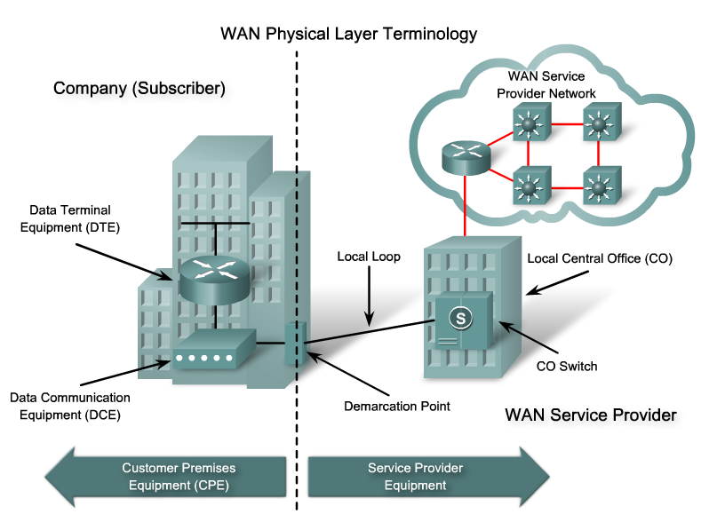
WAN Physical Layer Terminology

Slide 17
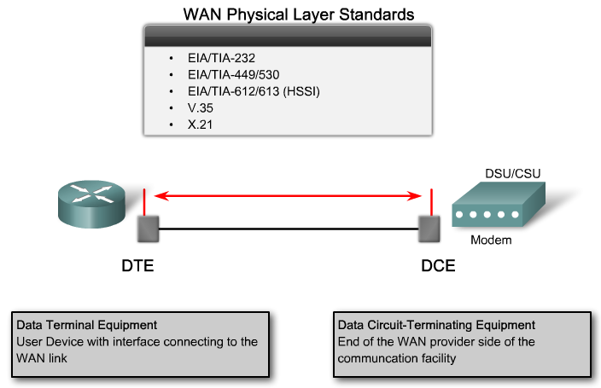
WAN Physical Layer Standards

Slide 18
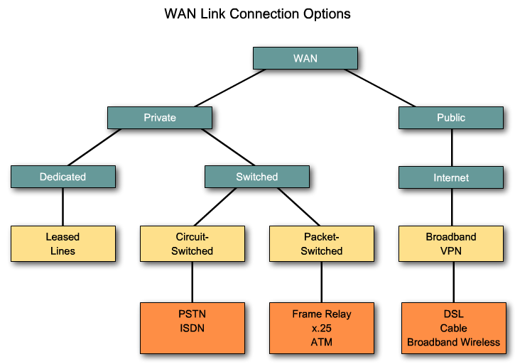
WAN Link Connection Types

Slide 19
Switched communication links
Switched communication links can be either circuit switched or packet switched.
  Circuit-switched communication links-Circuit switching dynamically establishes a dedicated virtual connection for voice or data between a sender and a receiver. Before communication can start, it is necessary to establish the connection through the network of the service provider. Examples of circuit-switched communication links are analog dialup (PSTN) and ISDN.

Slide 20
Switched communication links
  Packet-switched communication links-Many WAN users do not make efficient use of the fixed bandwidth that is available with dedicated, switched, or permanent circuits because the data flow fluctuates. Communications providers have data networks available to more appropriately service these users. In packet-switched networks, the data is transmitted in labeled frames, cells, or packets. Packet-switched communication links include Frame Relay, ATM, X.25, and Metro Ethernet.

Slide 21
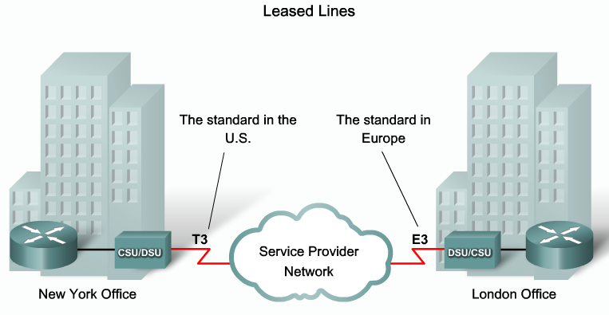
Leased line

Slide 22
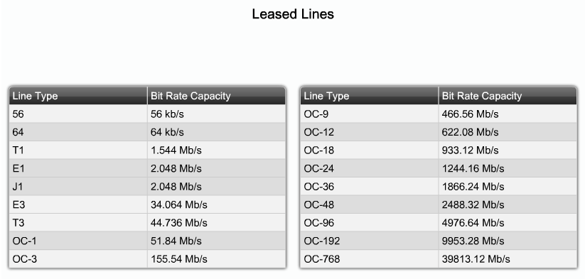
Leased line speed

Slide 23
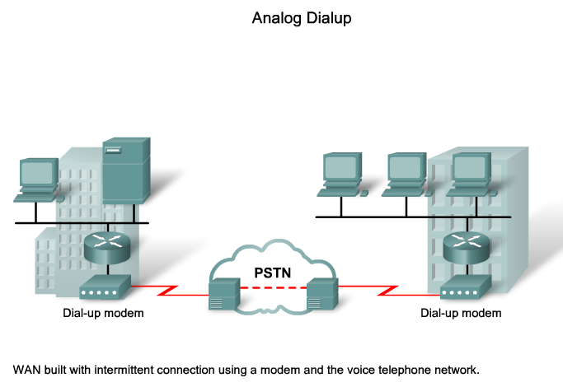
Analog Dialup

Slide 24
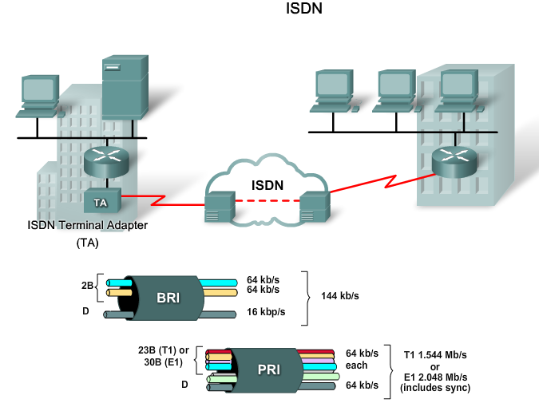
ISDN

Slide 25
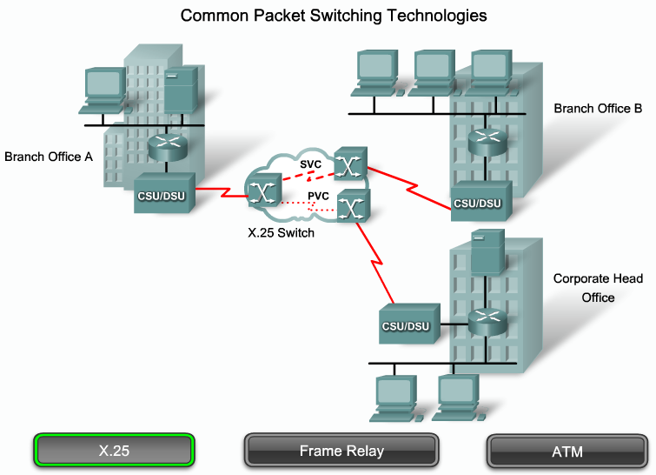
X.25

Slide 26
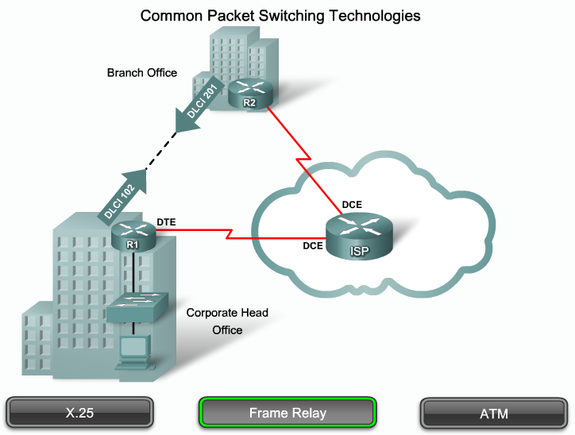
Frame Relay

Slide 27
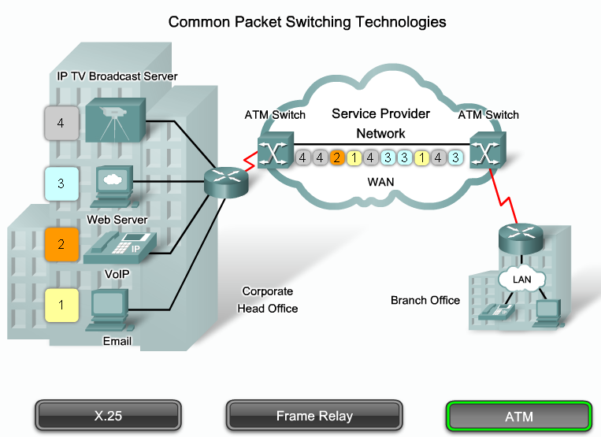
ATM

Slide 28
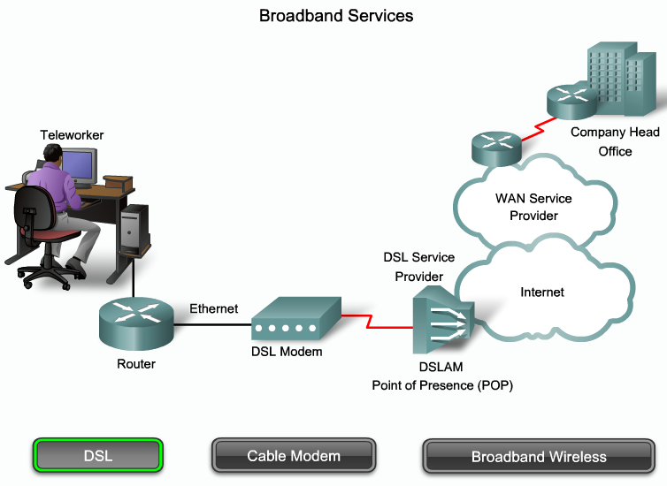
DSL

Slide 29
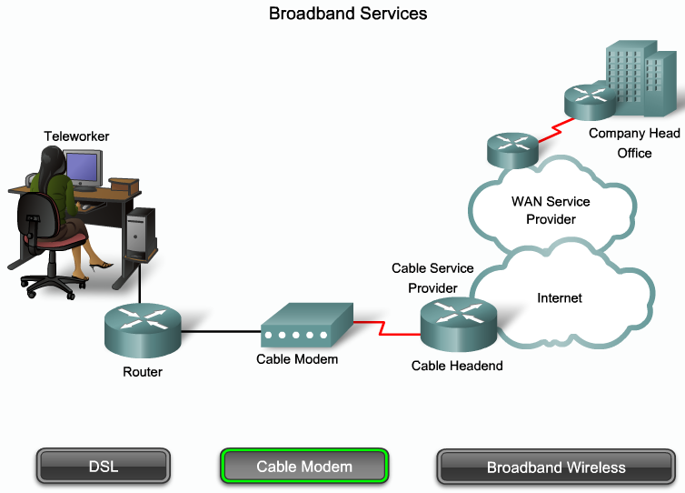
Cable Modem

Slide 30
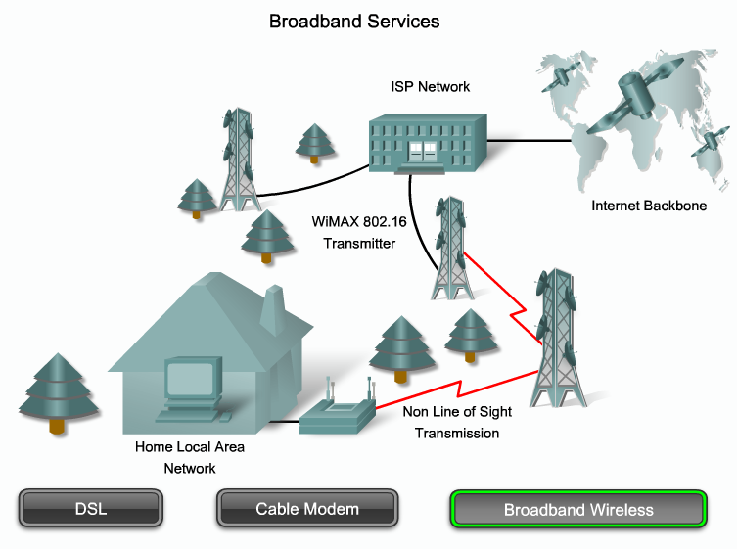
Broadband Wireless

